Slide 1

HealthTechNet 5/18/2018
www.SOCTelemed.com

Slide 2







SOC Telemed
LARGEST PROVIDER
OF ACUTE CARE
TELEMEDICINE SERVICES
SERVING OVER 450
HOSPITALS NATIONWIDE
FIRST AND LONGEST-STANDING
TELEMEDICINE ORGANIZATION
TO EARN JOINT COMMISSION ACCREDITATION (2006)
FULL-SERVICE
INNOVATION CENTER AND TECHNOLOGY TEAM
200+ PROVIDER
PHYSICIAN PRACTICE
24 X 7 X 365 COVERAGE
VIRTUAL HOSPITAL

Slide 3
Clinical Service Lines
teleNeurology
telePsychiatry
teleICU

Slide 4
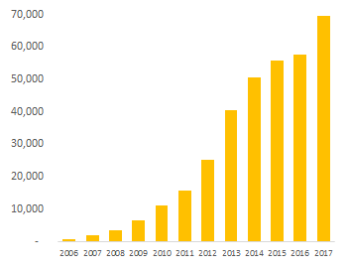
Clinical Experience
Critical Care
>2,000 on-demand consults
>15,000 SMARTRounds
21% tPA Administration Rate ~2% ICH Cases
>2,000 Cumulative Years of Clinical Experience
IVC Reversal Rates >40%

Slide 5

Hidden Obstacles to a Scalable Telemedicine Solution
Clinicians
Telemedicine Carts
Clinician Scheduling
Online Intake
Clinical Documentation
Hardware & Software
Clinician Recruitment & Training
Workflow Design and Optimization
Consult Coordination Center
Video Services
EMR Integration
Rule-Based Physician Dispatch
Project Management
Clinical Quality Monitoring
Clinician Performance Management
24/7 IT Support
PACS Integration
Demand and Supply Forecasting
Continuous Staff Training & Re-Training
Clinical Outcomes Tracking & Reporting
Clinician Applications and Tools
Credentialing, Licensing, and Privileging

Slide 6
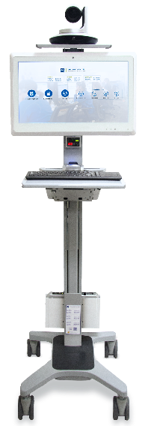
Telemedicine Barriers
Physician Licensure
Standards
Reimbursement
Acceptance
  By Physicians
  By Health Systems

Slide 7
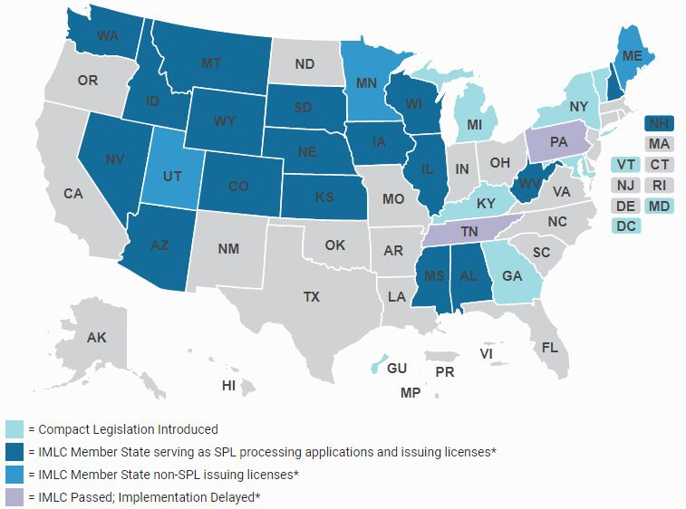
Physician Licensure
Requirement that licensure be determined by patient location
Licensure Compact moderately helpful
Licensure difficult with varied requirements
DEA numbers also required per state

Slide 8
Reimbursement
Variable availability
Driven by Medicare rules
CHRONIC Care Act may change landscape
  Potential for expansion of telehealth acceptance across Medicare populations
Still skepticism by payers
  Potential for abuse
  Difficulty in developing infrastructure to support billing

Slide 9
Standards
Nontraditional delivery in a tradition-bound space
Joint Commission standards accepted throughout industry
  Not necessarily specific to delivery of telemedicine
Two new efforts at specific telemedicine accreditation
  CHQI – affiliated with the ATA
  URAC – long history in healthcare standards
Help needed for consumers, medical boards, etc.

Slide 10
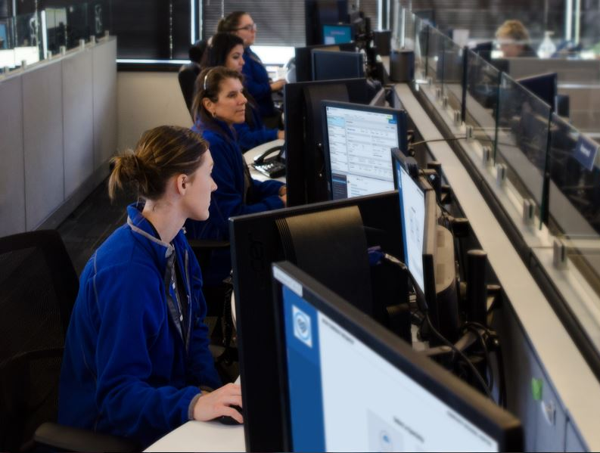
Acceptance
General acceptance by patients
Concern by hospitals and doctors
  Is it as good as live?
  Are you just trying to save money?
  Our patients expect better
  Is my job at risk?
  How does this work?

Slide 11

